Slide 1
Greedy Algorithms
Algorithms for optimization problems usually go through a sequence of steps
At each step, there is a set of possible choices
Some optimization problems can be solved using a simple approach
A greedy algorithm makes a choice at each step that looks best for the moment
That is, it makes a locally optimal choice
For some problems, this leads to a global optimum
For other problems, it does not lead to a global optimum
Later we will examine a more complicated method: dynamic programming

Slide 2
Greedy Algorithm Design
We use the following sequence of steps
  cast the optimization problem as one in which we make a choice and are then left with a single subproblem
  prove that there is always an optimal solution to the original problem that makes the greedy choice (so the greedy choice is always safe)
  demonstrate that after the greedy choice, the remaining sub-problem is such that if we combine the optimal solution to the sub-problem with the greedy choice that was made, the result is an optimal solution to the original problem.

Slide 3
Greedy Choice Property
Greedy Choice Property:
A globally optimal solution can be obtained by making a sequence of locally optimal choices
In other words, at each step, we make the choice that looks best for the current problem, without considering results from sub-problems.
Thus greedy algorithms typically take a top-down approach
Dynamic programming takes a bottom-up approach

Slide 4
Greedy Algorithm for Coin Changing
In the coin-changing problem, we are given a list of coin denominations and an amount A. The goal is to use as few of the coins as possible that total the amount A
The greedy approach is to first use as many coins of the largest denomination as possible, which then reduces the amount to a value A₁ less than the largest denomination.
We then use the remaining coin denominations to give the remaining change
using exactly the same strategy.
Thus we would use as many coins of the second largest denomination, reducing the amount to be produced again.
We continue until we reach the desired total.
The algorithm is a greedy algorithm because the local strategy (for each step) is to generate as large an amount as possible that is less equal the current amount using as few coins as possible.
It is obvious that this is done by giving as many coins of the largest possible denomination as possible.

Slide 5
Greedy Coin Changing
Given: - array denom of integers such that denom[1] > denom[2] > … > denom[n] = 1
- integer A
Goal: make change for A using as few entries from denom as possible
greedy_coin_change(denom,A) {
i = 1
    while (A > 0) {
    c = A/denom[i]
if ( c > 0 )
println(“use “ + c + “coins of denomination “ + denom[i]
A = A – c∗denom[i]
i = i+1
}
}

Slide 6
Does the greedy coin changing algorithm work? Yes and no. It depends on the denominations
If the denominations are 1, 6 and 10 the algorithm gives a non-optimal result for 12:
3 coins: one dime and two pennies. But we can use 2 6-cent pieces instead.

Slide 7
The algorithm does work for denominations 1, 5 and 10
We prove this by induction on A. Clearly you cannot do better for 1,2,3,4,5 and 10.
If 5 < A < 10, the algorithm uses 1 five and (A-5) ones for a total of A-4 coins. But if you do not use a 5, you must use A ones.
Now suppose A > 10 and the greedy algorithm works for all amounts less than A.
Let k be the number of coins used in an optimal solution for A.
Note that at most 4 coins of denomination 1 are used, because 5 ones can be replaced by one 5 for a net reduction of 4 coins.
Also at most one 5 is used, because two 5’s could be replaced with a 10.
Therefore the coins of denomination 1 and 5 can account for no more than 9 of the total of A. Since A > 9, at least one 10 coin is used.
If you remove the 10 piece, the remaining coins must be optimal for amount A-10.
By the inductive hypothesis, the change for A-10 was obtained by the greedy algorithm.
But if we add in the 10 piece, this also arises from the greedy algorithm.

Slide 8
Greedy Example: Optimal Cell Tower Placement
Scenario:
Long, straight, quiet country road with houses scattered very sparsely along it.
All residents are important people and are avid cell phone users.
The range of your cell phone towers is 4 miles.
Your goal: place cell phone towers along the road so that every residence is covered, using as few cell phone towers as possible.
Model:
A straight line with a left endpoint and right endpoint, a list x₁, …, x_{n} of locations for the individual houses (distance from the left endpoint)
Solution: a sequence of real values c₁, …, c_{m} such that
(1) for every i from 1 to n, there is a j from 1 to m so that |c_{j} - x_{i}| <= 4
(2) m is as small as possible subject to condition (1)

Slide 9
Cell Tower Placement
Model:
The road is modeled as a straight line with a left endpoint and a right endpoint.
The house positions are given by their distance from the left endpoint, say
h₁, h₂, …, h_{m}. The output will be the cell tower distances from the left endpoint.
Greedy approach:
We want to place the first tower so that it covers the first house and as many more as possible; obvious choice: position h₁ + 4.
Having placed k of the towers, if we have not yet covered all houses, place the k+1st tower so that it covers the first uncovered house and as many beyond that as possible.
Thus if h_{j} is the first house (from left to right) not covered so far, put the next tower at position h_{j} + 4.
How would you prove that the above algorithm uses as few towers as possible?

Slide 10
Continuous Knapsack Problems
Input: a collection of objects such that each object has an associated
weight and profit; and a total weight bound C.
Goal: choose an amount of each object between 0 and 1 so that the sum
of the corresponding total profit is as large as possible
In this version of the problem, we do not have to take all of an object; we may subdivide it and take a part of the object.
If p is the proportion of the object taken, then the profit derived from the object is p times the profit value of the entire object
In the above, 0 ≤ p ≤ 1
This version is known as the continuous (or fractional) knapsack problem
If we must either take all of the object (p = 1) or none of the object (p = 0), this version of the problem is called the 0/1-knapsack problem

Slide 11
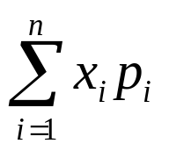
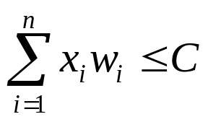
Precise Statement – Continuous Knapsack Problem
Precise statement
Suppose we have n objects so that the i^{th} object has weight w_{i} and profit value p_{i}
We are to find real values x₁,x₂,…,x_{n} between 0 and 1 that maximize the total profit
subject to the constraint
Example (w₁,p₁) (w₂,p₂) (w₃,p₃) (w₄,p₄) (w₅,p₅) C
(120,5) (150,5) (200,4) (150,8) (140,3) 600
If we take all of items 1, 2 and 4, 180 units of item 3 and none of item 5 we have values x₁ = 1, x₂ = 1, x₃ = 180/200 = 0.9, x₄ = 1 and x₅ = 0.
Then the total weight is 120 + 150 + 180 + 150 = 600
and the total profit is 1∗5 + 1∗5 + 0.9∗4 + 1∗8 = 21.6

Slide 12
Greedy Knapsack
In the homework, you will be asked to show that a greedy algorithm cannot be based on weight alone or profit alone
That is, if you always choose the minimum weight for the next guy to add (or the maximum weight), you will not necessarily maximize the total profit
Similarly, if you always choose the next item to be the one with the most profit regardless of weight, you will not always get an optimal solution
Instead, you should consider the profit/weight ratios, i.e., the amount of profit per unit weight
Thus the greedy algorithm specifies that you are to select the objects in non-increasing order of their price-to-weight ratio. You take all of the object if it will not exceed the capacity, otherwise you take as much as you can to reach the capacity.

Slide 13
Example
Recall our example:
(w₁,p₁) (w₂,p₂) (w₃,p₃) (w₄,p₄) (w₅,p₅) C
(120,5) (150,5) (200,4) (150,8) (140,3) 600
The profit/weight ratios are
p₁/w₁ = 5/120 = .0417; p₂/w₂ = 5/150 = .0333; p₃/w₃ = 4/200 = .0200;
p₄/w₄ = 8/150 = .0533; p₅/w₅ = 3/140 = .0214;
Thus the order of consideration is 4, 1, 2, 5, 3
We take all of items 4, 1, 2, and 5 for a total weight of 150 + 120 + 150 + 140 = 560
We now only have room for 40 units of weight, so we take 40/200 = 1/5 of object 3
The profit is thus 5 + 5 + 0.2⋅4 + 8 + 3 = 21.8

Slide 14
Greedy Knapsack Algorithm
continuous_knapsack(a,C) { // a is an array of items with weight, profit & id fields
n = a.last
for i = 1 to n
ratio[i] = a[i].p/a[i].w
sort(a,ratio)
weight = 0
i = 1
while ( i ≤ n && weight < C ) {
if (weight + a[i].w ≤ C) {
println(“Select all of object “ + a[i].id)
weight = weight + a[i].w
}
else {
r = (C-weight)/a[i].w
println(“Select “ + r +“ of object “ + a[i].id)
weight = C
}
i = i+1
}
}

Slide 15
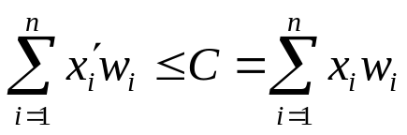
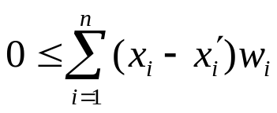
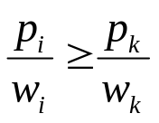
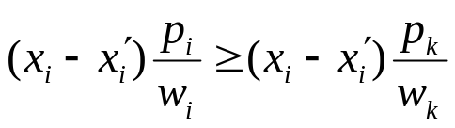
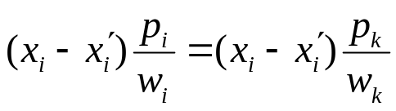
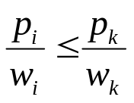
Proof of Correctness
We can assume total weight exceeds capacity C
Let x_{i} denote the portion of object i selected by the algorithm and let P be the total profit produced by the algorithm
Consider an arbitrary solution with portion amounts x_{i}′ and total profit P′. We will show that P′ ≤ P, which proves that the greedy solution is optimal
Since , we have
If k is the least index with x_{k} < 1 and i < k, then x_{i} = 1 and thus x_{i}-x_{i}′ ≥ 0.
Objects sorted in nondecreasing order of the ratio p_{i/}/w_{i} so for all i < k
Thus if i < k, then
If i = k, then
If i > k, then x_{i} = 0 and thus x_{i}-x_{i}′ ≤ 0. Also, by the sorted property,
Therefore, we again have

Slide 16
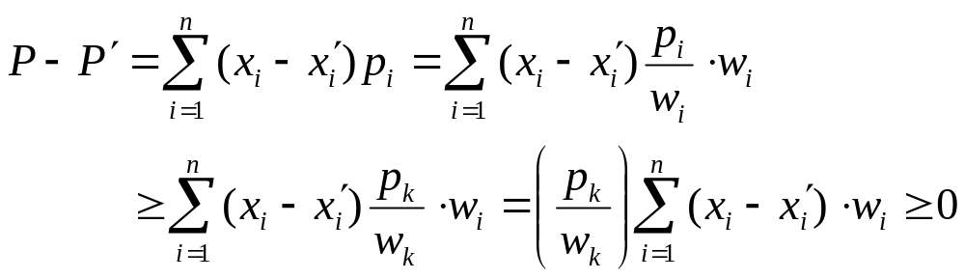
Proof of Correctness
On the previous slide we showed that for all k with 1 ≤ k ≤ n:
Recall that P is the greedy profit and P′ is the optimal profit
Thus the difference in the profits is
Thus P ≥ P′ and thus P = P′ , since P′ is the maximum possible profit

Slide 17
Homework
Page 274: #2
Page 318: #2

